Slide 1
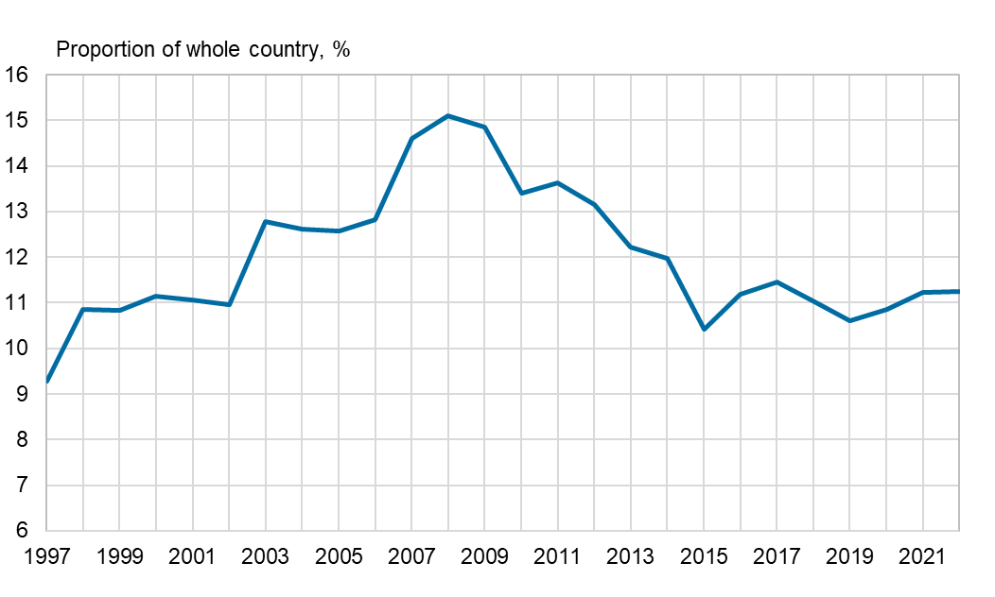
R&D expenditure in the Oulu region, 1995–2021
The statistics methodology has been revised concerning higher education sector. Thus data for the year 2011 is not fully comparable to the previous year's data.
Source: Statistics Finland

