Slide 1
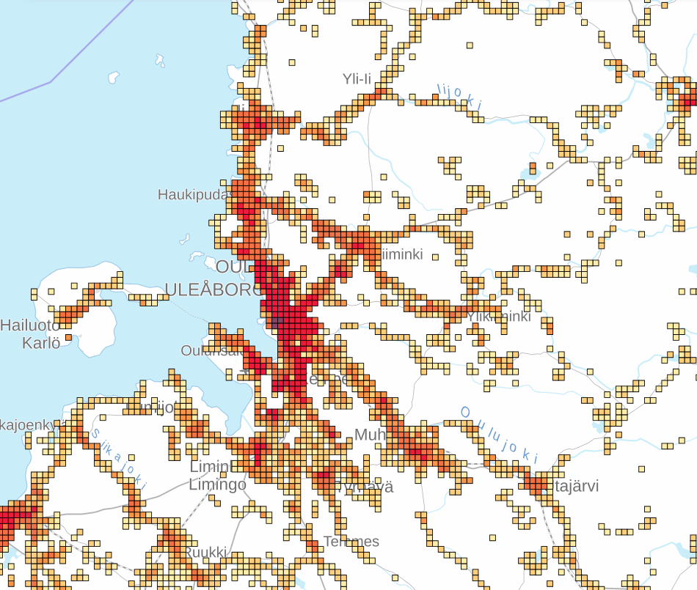
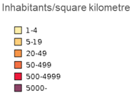
Population density in Oulu region, 2022 Kilometre × kilometre squares
Source: Statistics Finland

