Slide 1
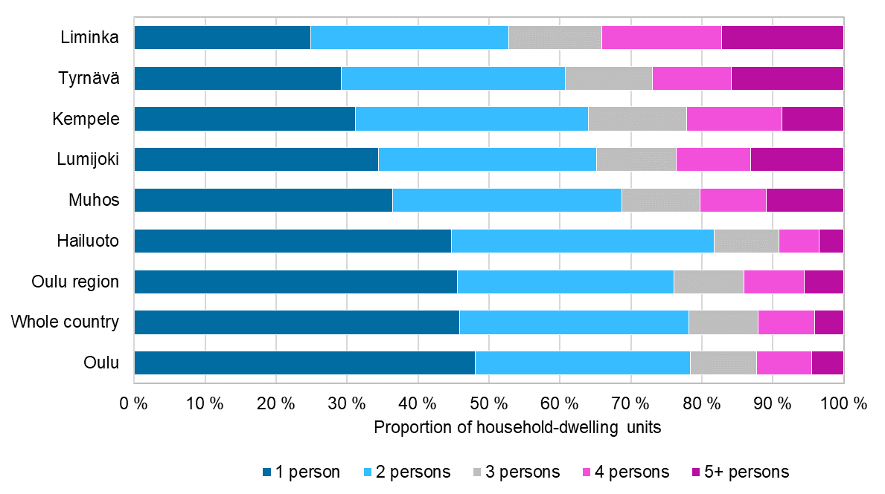
Size of household-dwelling unit by municipality, 2022
2023 regional boundaries
Source: Statistics Finland

