Slide 1
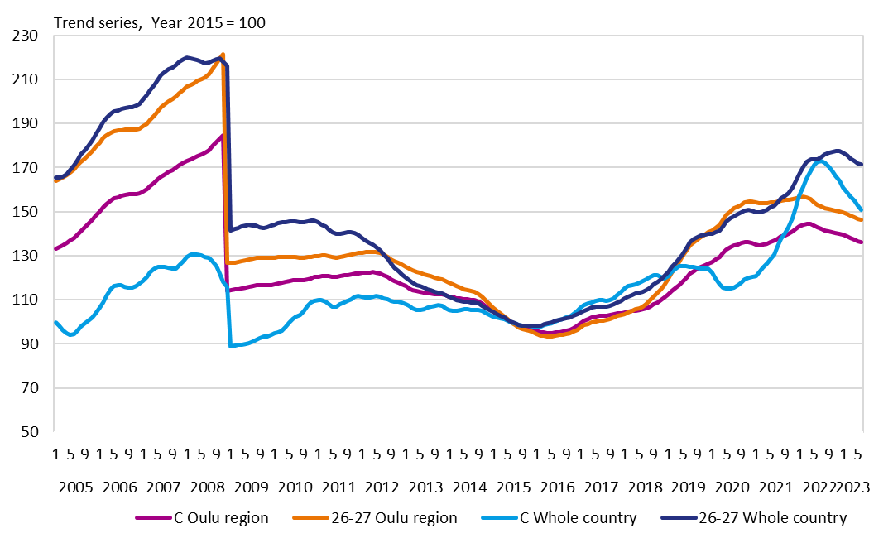
Development of exports in the Oulu region and in the whole country 2005–2023 C Manufacturing, 26-27 Manufacture of fabricated metal products and manufacture of computer, eletronic and optical products
Source: Statistics Finland

