Slide 1
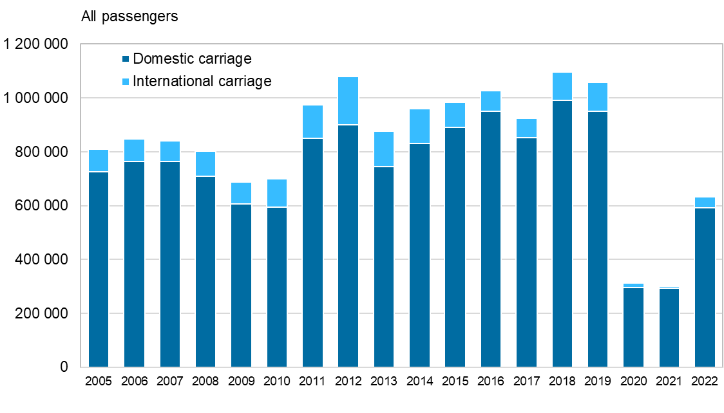
Number of passengers at Oulu airport, 2005–2022
Statistics Finland,
Source: Finavia

