Slide 1
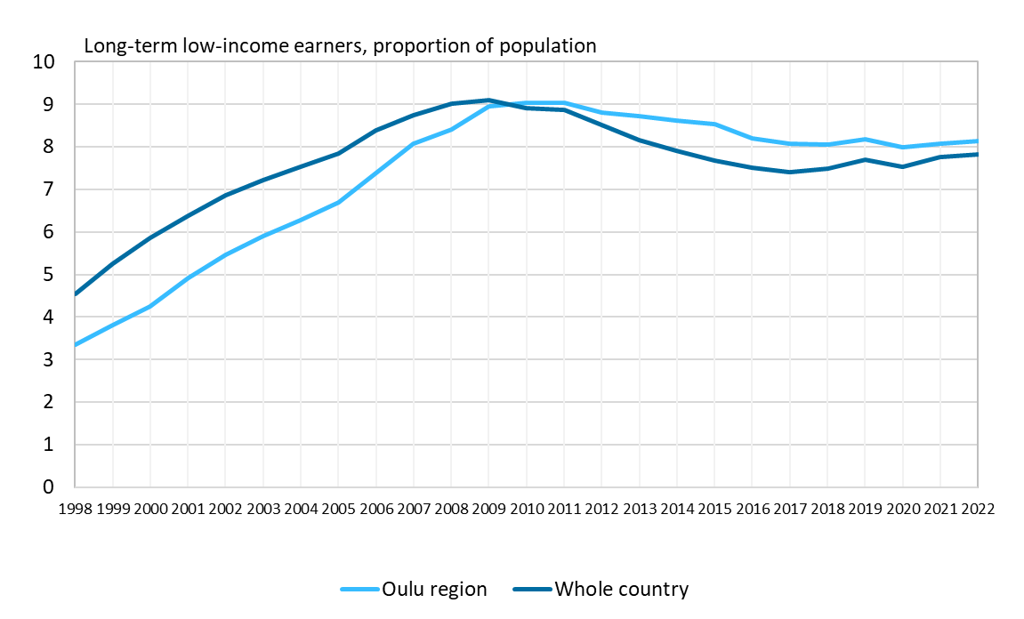
Low-term income earners in the Oulu region and in the whole country, 1998–2022
Source: Statistics Finland

