Slide 1
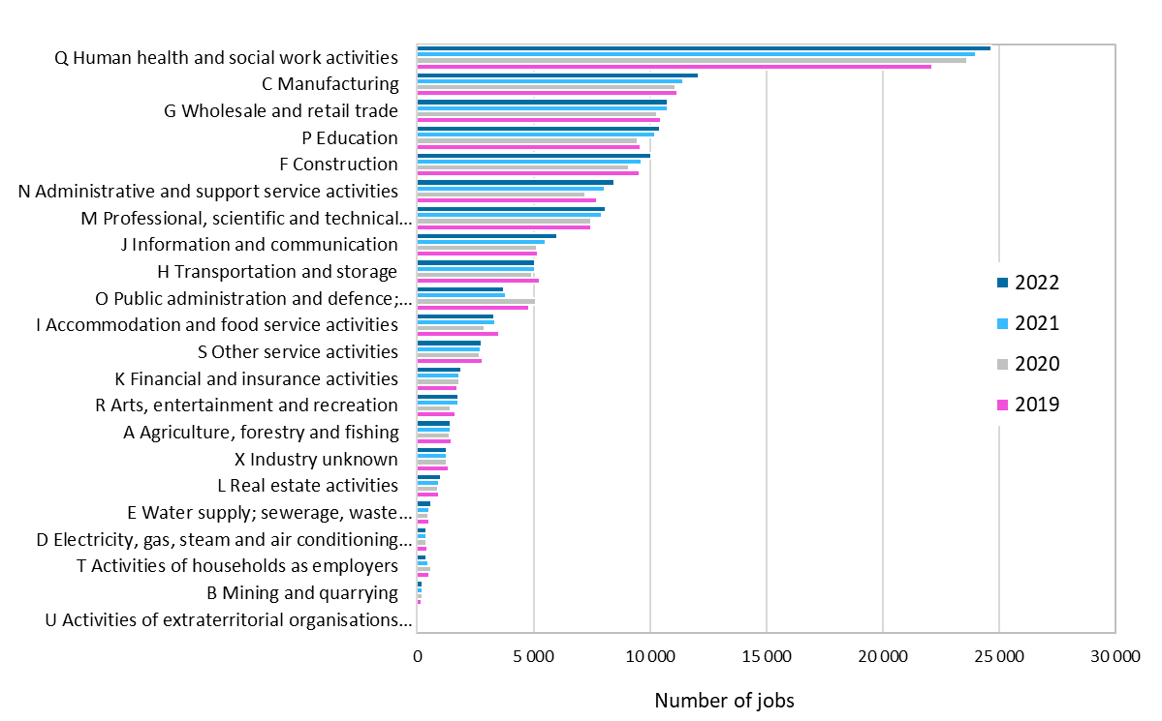
Jobs by industry in the Oulu central region, 2019–2022
Source: Statistics Finland

