Slide 1
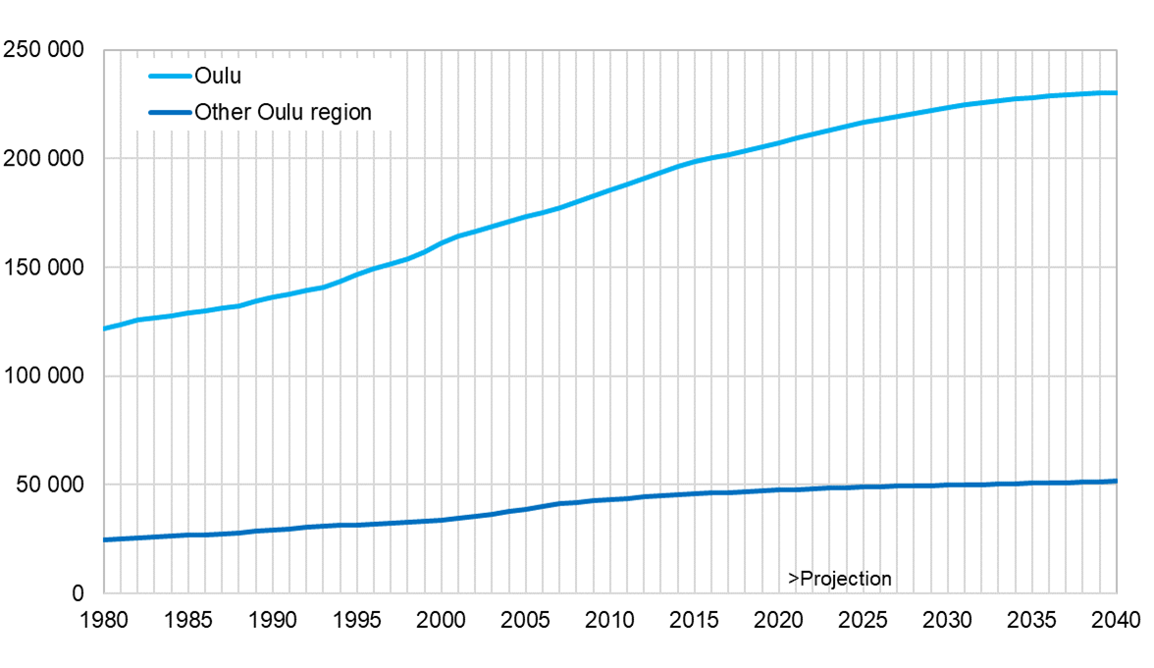
Population in the Oulu region 1980–2021 and projection for the year 2040
Source: Statistics Finland

