Slide 1
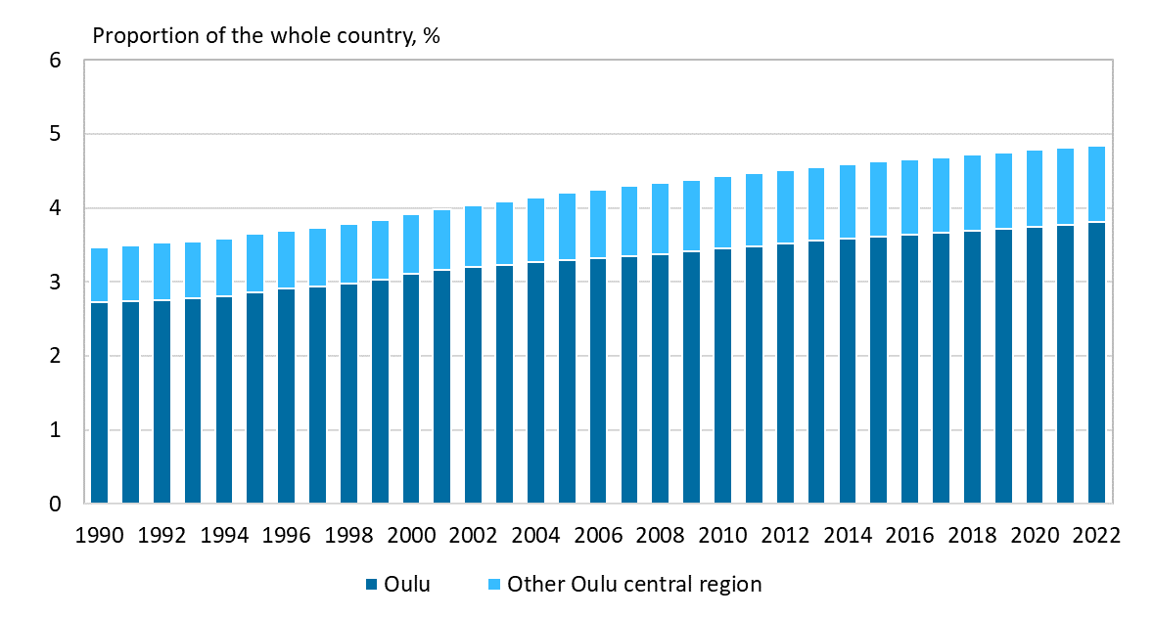
Population in the Oulu central region, 1990–2021
2023 regional boundaries
Source: Statistics Finland

